Slide 1

Платформа Microsoft для образования

Slide 2
ПЛАН
Обзор платформы Microsoft
«3 Экрана + Облако» Настольные приложения Веб-приложения Мобильные приложения Платформа Microsoft Cloud Computing Платформа Microsoft в учебном процессе
Итоги

Slide 3














PC
Кросс-средства разработки
Сервера
Облако

Slide 4











CLIENT
SERVER
SERVICES
Applications
Developer Tools
Programming Model
Application Services
Relational Database
Operating System
Systems Management
Notes:
Putting everything together, results in a comprehensive platform and set of applications that spans the client, server and services tiers. For simplicity’s sake, this diagram only includes Microsoft’s technologies but Microsoft’s success has been the result of the hundreds of thousands (over 600,000) partners building platform components and applications that address a large proportion of the world’s software needs.

Slide 5
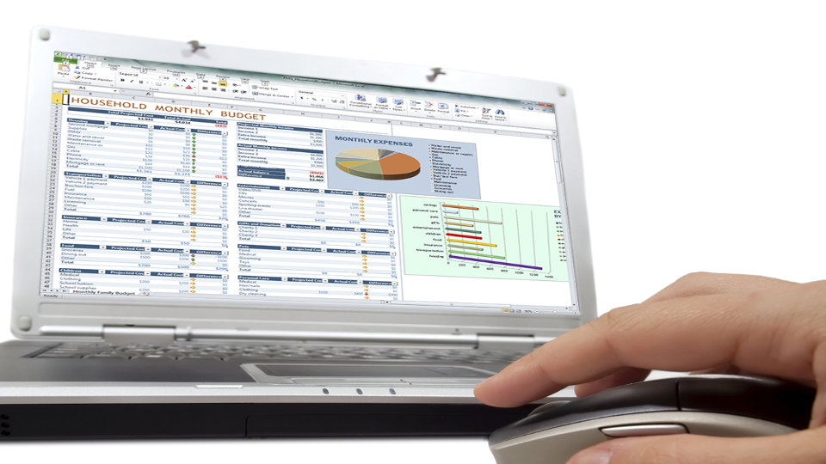

Slide 6
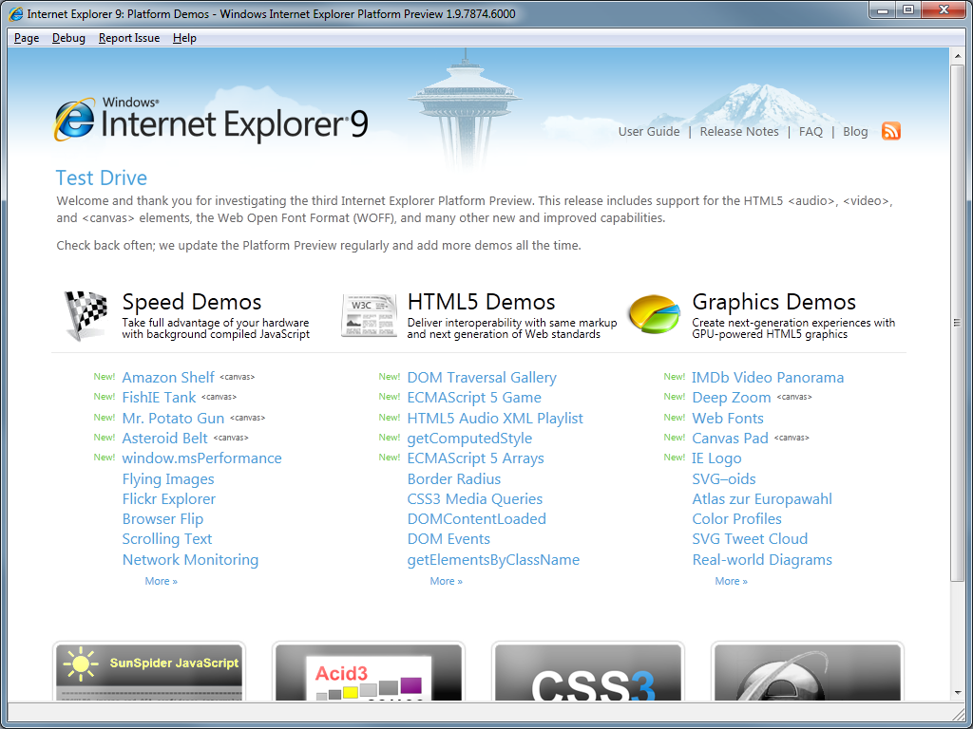

Slide 7


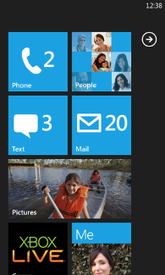
Capacitive touch
4 и более контактных точек
800 или 480
Сенсоры
A-GPS, Accelerometer, Compass, Light, Proximity
Камера
5 МП и более
Мультимедиа
Единые спецификации, Codec acceleration
Память
256MB RAM и более, 8GB Flash и более
GPU
DirectX 9 acceleration
CPU
ARMv7 Cortex/Scorpion и более
Аппаратные кнопки | Back, Start, Search
480 или 320

Slide 8

ЧТО
ВЫЧИСЛИТЕЛЬНЫЕ РЕСУРСЫ И ПРИЛОЖЕНИЯ
ЧЕРЕЗ ИНТЕРНЕТ В ВИДЕ СЕРВИСОВ
ЗАЧЕМ
ГИБКОСТЬ, СКОРОСТЬ, ЭЛАСТИЧНОСТЬ & СНИЖЕНИЕ ЗАТРАТ

Slide 9

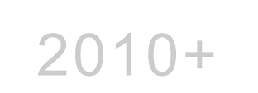




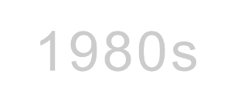

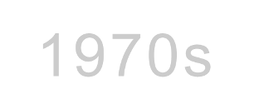

2000s
SOA
1990s
Web
Client-Server
Mainframe
Notes:
The history of technology is characterized by periods of particularly rapid evolution.
The adoption of the PC by businesses in the 90s dramatically altered the staid, mainframe/mini-computer dominated world of enterprise IT and empowered individuals to apply technology creatively and broadly across business to the point where – today – it’s almost unimaginable to consider working without a PC.
In the middle of the 1990s the Web emerged, and a whole generation of Internet-facing Web applications, both Internet, and intranet within a corporation, were built using HTML and Web servers. And we see many, many thousands, hundreds of thousands of these being written every year. It is still a core model that people use for building modern applications.
In the early 2000s Web services and SOA (Service-Oriented Architecture) enabled applications to communicate over standard-based Web protocols, be it Web services, or REST-based protocols, and this is also very popular particularly because it promotes the ideal of assembling – or composing – more complex solutions from simpler parts. In fact, it is a core building block for how we think about the Azure services platform.
There are many advantages to the services model particularly with the immediacy of global reach, the ease of provisioning and, of course, allowing a 3rd party with the greater expertise to run the computers, networks, data-centers and software on my behalf. However, there are many advantages to running software on premises too. Principally, the ability to tailor the software to most effectively address specific business needs and the level of privacy and control that can only be guaranteed when the software and data are within my control.
The cloud platform builds on previous platform generations but it is a fundamentally different approach and it has its own unique advantages.

Slide 10
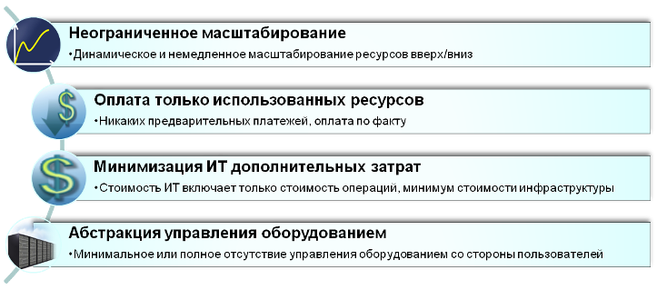

Что такое «облачные технологии»
Облачные технологии (Cloud Computing): приложения и oборудование, их исполняющее, предоставляются как сервисы через Internet.
Облако (Cloud):Оборудование и специализированное ПО/среда исполнения.
Источники:
“A Break in the Clouds: Towards a Cloud Definition”, 2009; Vaquero, Rodero-Merino, Caceres, Linder
"Above the Clouds: A Berkley View of Cloud Computing", 2009; UC Berkley Reliable Adaptive Distributed Systems Laboratory
“Clearing the air on cloud computing”, 2009; McKinsey & Company
Notes:
Based on industry views of the likes of UC Berkley RAD Labs, MCKinsey, Gartner, Forrester, etc. the lowest common denominator attributes required for cloud computing are …..

Slide 11











Inactivity
Period
Compute
Compute
Average
Usage
Average Usage
Time
Time
Compute
Compute
Average Usage
Average Usage
Time
Time

Slide 12
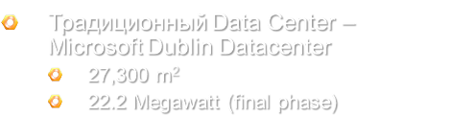

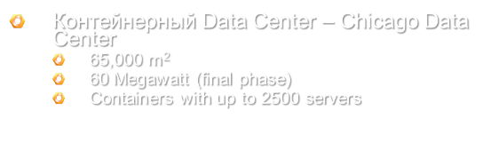
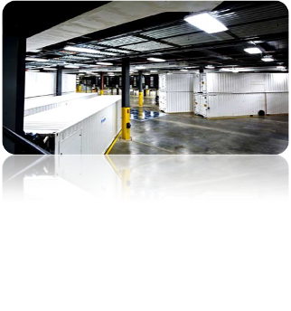
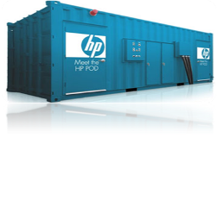

© www.datacenterknowledge.com
© www.datacenterknowledge.com

Slide 13

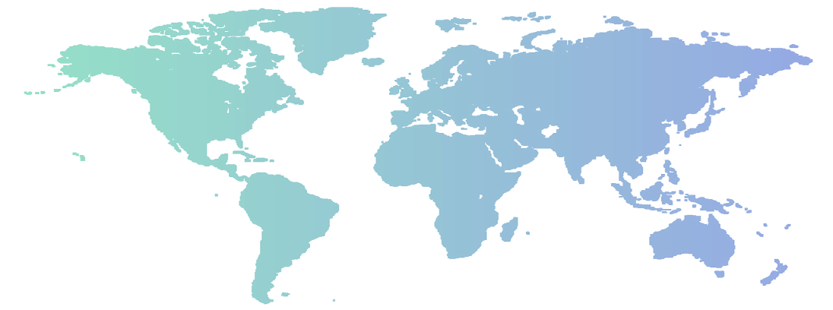











Плюс еще 150 сервисов и ЦОД
Notes:
Stats!
Did you know Windows Live ID handles 1 Billion authentications per day?
Did you know Bing handles over 2 Billion queries per month?
Did you know we have 320 Million Live Messenger accounts handling 8.2B messages/day
375M active hotmail accounts, block 3.4B spam messages/day
MSN gets 570M unique vistors monthly day
Exchange hosted services (EHS/FOSE) processes 2-4 Billion emails a day securing corporate environment email?
We keep Microsoft’s Live, Online and Cloud Services running around the world, around the clock
Our group runs over 200 Microsoft services that have hundreds of millions of customers around the world
we’re held up to a very high bar
uptime, availability and quality are the focus of our business and the measures of our success
the services have different needs based on their business model and customer promises, so our environment also has to be flexible
We have to make sure we’re providing the infrastructure and operations support so our services can deliver for our end-users wherever they are
We run this infrastructure on Windows
Hundreds of thousands of Windows servers in our environment
Use all the Microsoft Server products and technologies extensively
Using virtualization in multiple ways – to meet the needs of the different types of services
Microsoft opened its first data center in September of 1989 (with security, raised floors for cables, environmental control, etc.). (Note: it was located at the Redmond, WA campus in Building 11)
We built our first large-scale, Generation 2-type data center from the ground up in 2006 – in Quincy, WA
Some Service Statistics:
Bing Search
2.16B queries per month
Index includes: 20B+ documents, 400M+ images, 7M+ instant answers
MSN
465M unique users
42 markets
21 languages
10B + page views per month
Windows Live
Live ID: 1B+ Authentications/day
Hotmail: 350M+ active accts, block 3.4B spam messages/day
Messenger: 8.2B messages/day
Spaces: 8M photos uploaded/day
Suite: 265M downloads

Slide 14






















Slide 15
ПЛАН
Обзор платформы Microsoft
«3 Экрана + Облако» Настольные приложения Веб-приложения Мобильные приложения Платформа Microsoft Cloud Computing Платформа Microsoft в учебном процессе
Итоги

Slide 16



Slide 17

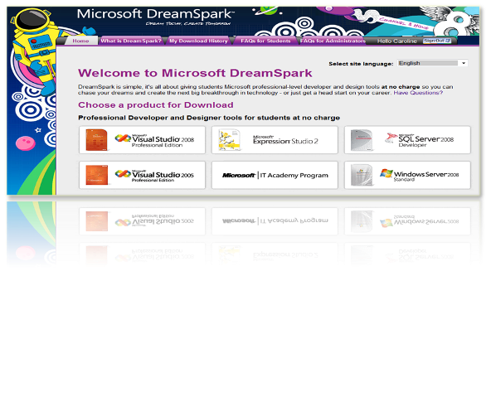
www.dreamspark.com

Slide 18











Не только e-mail, но и доступ к другим сервисам Windows Live и Microsoft online services.
Mailbox
Alerts
Calendar
Office Live Workspaces
Contacts
SkyDrive®
Mobile
SharedView
Messenger
anna@student.university.ua
Password: *******
Plus even more services in beta…
Spaces

Slide 19

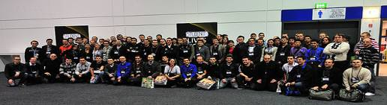

Slide 20
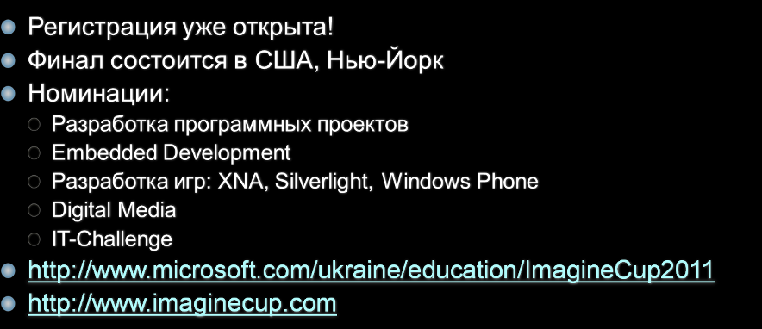
Imagine Cup 2011

Slide 21
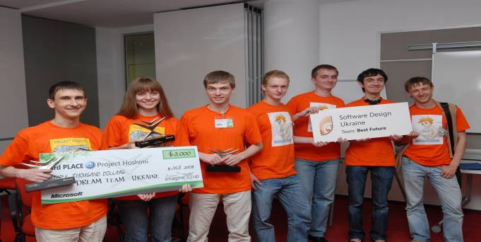

Slide 22
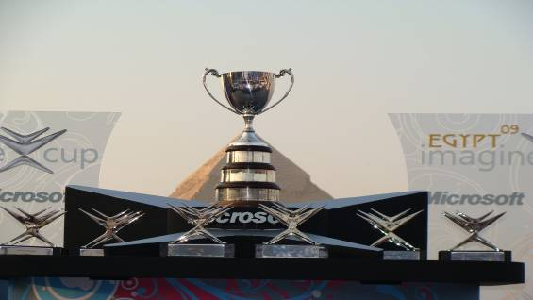
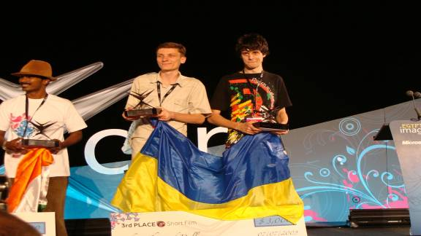
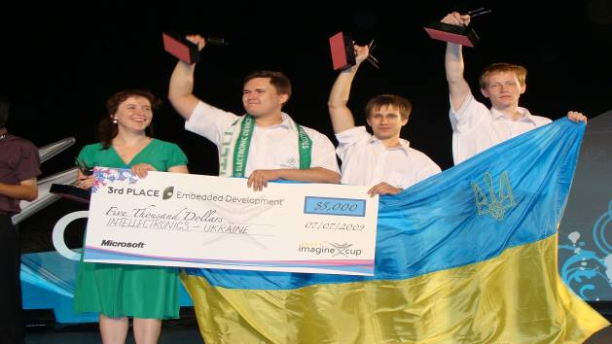
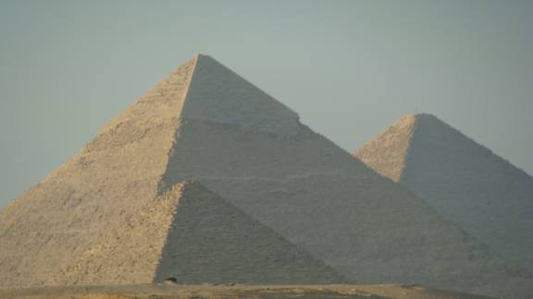


Slide 23

Imagine Cup 2011

Slide 24
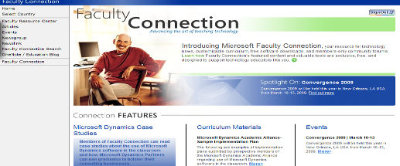
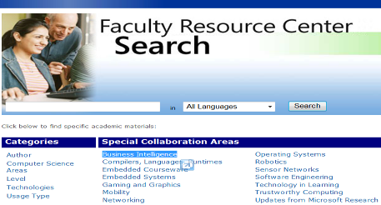
Бесплатное ПО для преподавателей (как DreamSpark)
>2,500 учебных материалов по информатике и программной инженерии
В основном, на английском языке
www.microsoft.com/education/facultyconnection/

Slide 25
ПЛАН
Обзор платформы Microsoft
«3 Экрана + Облако» Настольные приложения Веб-приложения Мобильные приложения Платформа Microsoft Cloud Computing Платформа Microsoft в учебном процессе
Итоги

Slide 26


Slide 27
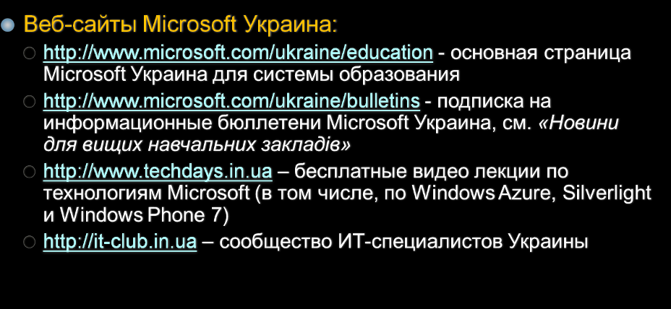

Slide 28

© 2010 Microsoft Corporation. All rights reserved.
This presentation is for informational purposes only. Microsoft makes no warranties, express or implied, in this summary.
Microsoft and Your potential. Our passion. are trademarks of the Microsoft group of companies.
The names of actual companies and products mentioned herein may be the trademarks of their respective owners.
Microsoft Corporation • One Microsoft Way • Redmond, WA 98052-6399 • USA

